Slide 1
Design of Safety Critical Systems
Group Three
Course Exercise

Slide 2
Customer Requirements
Safely prevent uncontrolled movements
Retro-fit to existing prams
Must not compromise existing safety performance of pram
Must not compromise generally functionality of pram
Affordable
Easy to fit
Aesthetically pleasing and sympathetic to existing pram design
Operator comfort should not be compromised

Slide 3
Customer Requirements
Easy to reset
Reliability
Must not compromise the stability of the pram.
Lightweight
Maintenance Free
Conventionally safe
Sensible power demands

Slide 4
Engineering Requirements
Safely prevent uncontrolled movements
Detect uncontrolled movement
Stop uncontrolled movement with a minimum deceleration of x ms⁻² maximum deceleration of x ms⁻²
Retro-fit to existing prams
Maximum dimensions of x, y, z
Adjustable attachment method
Must not compromise existing safety performance of pram
Independent means of braking.
Must not compromise general functionality of pram
Independent from all other functions (e.g. folding, existing braking, ability to seat child).

Slide 5
Engineering Requirements
Affordable
Total costs shall not exceed XXGBP.
Easy to fit
Maximum installation time of XXs (without tools).
Aesthetically pleasing and sympathetic to existing pram design
Comes in a range of colours
Operator comfort should not be compromised
No change to operator actions and activities.
Easy to reset
Ability to reinstate pram movement within Xs operator intervention.
Reliability
Failure rate of no greater than 10⁻⁶ per demand.

Slide 6
Engineering Requirements
Must not compromise the stability of the pram.
Must not raise the CofG.
(For fault scenario see requirement (1)).
Lightweight
Mass must not exceed Xkg.
Maintenance Free
Must not require any planned or preventative maintenance
Conventionally safe
Must comply with all relevant UK safety standards.

Slide 7
Functional Decomposition
Sense loss of
control
Stop the pram
Sense pram in motion

Slide 8
Concepts
Parachute
Parachute deploys on pram speed exceeding Xms⁻¹
Parachute increases air resistance of the pram, thus bringing it to a stop.
Dead Man’s Handle
Release of bowden cable engages brake.
Brake increases friction on the axle
Pram movement ceases.
Explosion-deployed momentum equaliser.
Safety Cable
Cable fixed to the operator and the pram axle via quick-release handlebar attachment.
Capacitance triggered brake.
Detects operator releasing pram by loss of capacitance across a sensor on the handlebar, triggering brake on axle.

Slide 9
Options Matrix
Engineering Requirement | 1 | 2 | 3 | 4 | 5 | 6 | 7 | 8 | 9 | 10 | 11 | 12 | 13 | 14
Concept A | ✖ | ✔ | ✖ | ✖ | ✖ | ✖ | ✔ | ✔ | ✖ | ✔ | ✖ | ✖ | ✖ | ✖
Concept B | ✔ | ✔ | ✔ | ✔ | ✔ | ✔ | ✔ | ✔ | ✔ | ✔ | ✔ | ✔ | ✔ | ✔
Concept C | ✖ | ✖ | ✖ | ✖ | ✖ | ✖ | ✔ | ✔ | ✖ | ✔ | ✖ | ✖ | ✖ | ✖
Concept D | ✔ | ✔ | ✔ | ✔ | ✔ | ✔ | ✔ | ✖ | ✔ | ✔ | ✔ | ✔ | ✔ | ✔
Concept E | ✔ | ✔ | ✔ | ✔ | ✖ | ✖ | ✔ | ✔ | ✔ | ✔ | ✔ | ✔ | ✔ | ✔

Slide 10
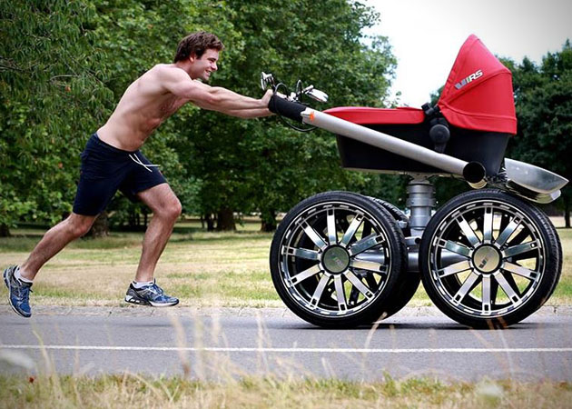
Concept B – PramScram™

Slide 11
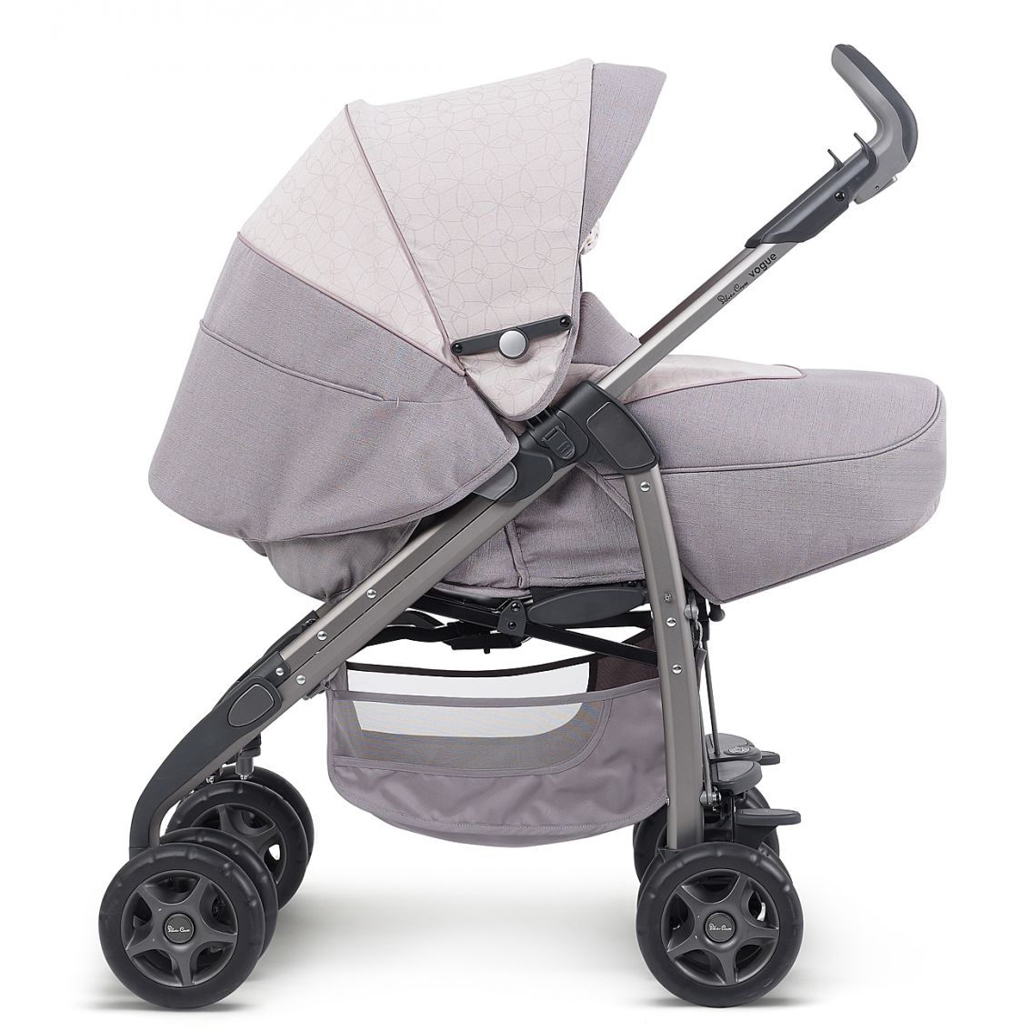
Description of Solution
Handle
Cable
Brake

Slide 12
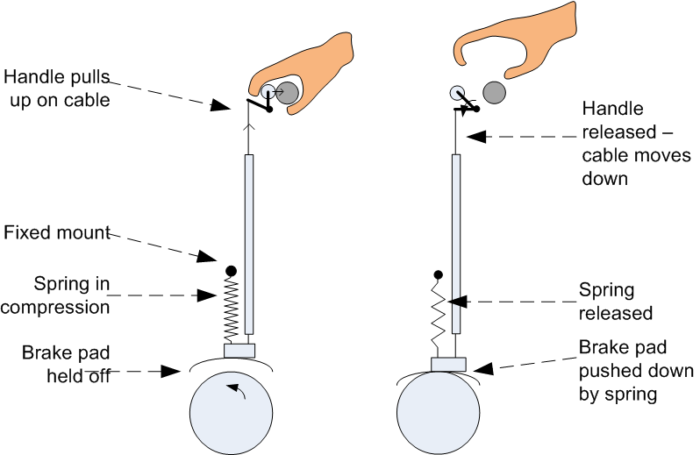
Description of Solution

Slide 13
HAZOP
Node | Guideword | Deviation | Possible cause | Result | Action required
Handle | none | No handle | -Handle drops off -Not fitted correctly by user | Pram immobile | -Quality control, good materials -Human factors to ensure easy to fit -Designed to withstand vibration
Handle | More of | Handle resistance too great | Incorrect setup | Pram immobile | Add knob to adjust cable tension
Brakes | Too fast | Brakes too harshly | Spring tension too great | Harsh deceleration | Specify spring tension range Specify spring lifetime
Brakes | Too slow | Insufficent braking | Worn pads | Pram runaway | Lifed item
System | Does not move | mechanism siezed | corrosion | No brakes applied, pram runaway | use corrosion resistant materials

Slide 14
Fault Tree Analysis
1e-5
Runaway Pram
Or
2e-7
Fault with Control
Fault with Brake
1e-5
Cannot claim 10⁻⁷ figure as we cannot assume maintenance will be conducted
Or
Or
Handle locks in position
Spring Fails
Friction reduced due to environment
Pad falls off
Worn pad
1e-7
1e-7
1e-7
1e-7
1e-5

Slide 15
2e-7
Runaway Pram
Or
Fault with Handle
2e-7
Fault with Brakes
1e-10
Or
And
Or
Handle locks in position
Spring Fails
1e-7
1e-5
Friction reduced due to environment
Pad falls off
Worn pad
Or
1e-7
1e-7
1e-7
Friction reduced due to environment
Pad falls off
Worn pad
1e-7
1e-7
1e-5

Slide 16
Safety Integrity Level
Equipment under control – Pram
Existing risk of runaway linked to human error of omission ≈ 10⁻³
PramScram safety system designed to reduced this risk to a minimum of 10⁻⁶ (SIL 1)
Actual risk of runaway reduced to 2x10⁻⁷.

Slide 17
Safety Case
Confirm Design and Scope
Hazard Identification (including HAZOP)
Fault Schedule – List of reasonably foreseeable faults or events (can be grouped).
Derivation of SFRs – Requirements of the design required to keep pram safe.
Deterministic Assessment – (Pessimistic) assessment that design meets requirements (Design Substantiation)
Probabilistic Assessment – (Realistic) assessment that risks are within prescribed limits
ALARP Assessment – Has everything been done to reduce risks
Implementation of any safety mechanisms or instructions to operators.

